Slide 1

April 5, 2017
Generative Adversarial Networks
Dr. Victoria Mazo
Zebra Medical Vision

Slide 2
Yan LeCunn:
“GANs is the most interesting idea in the last 10 years in Machine Learning”

Slide 3
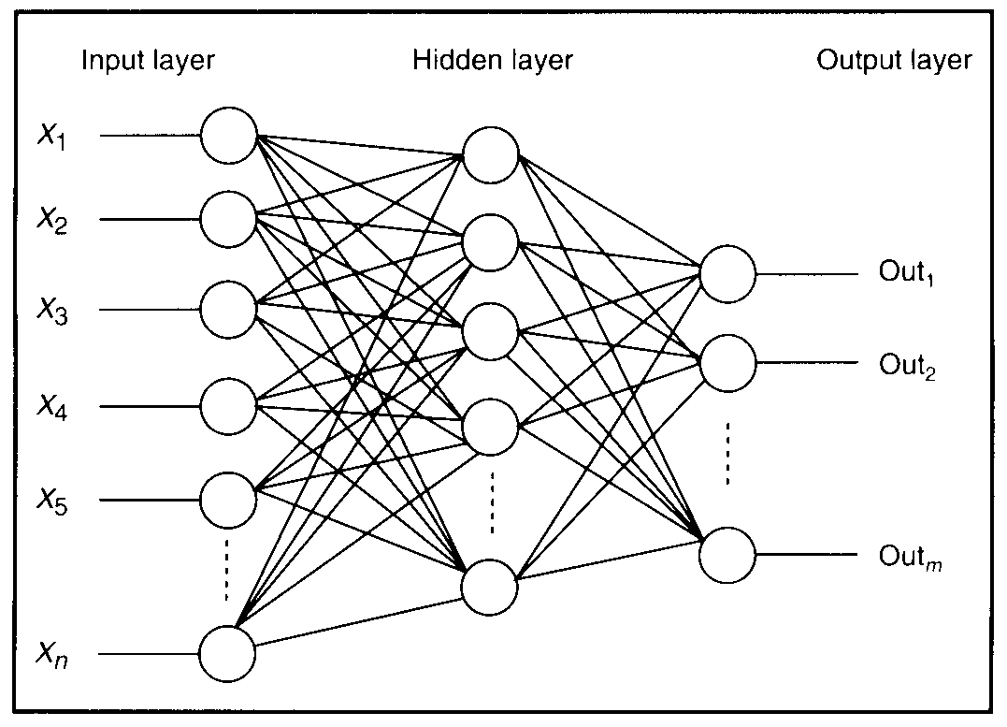
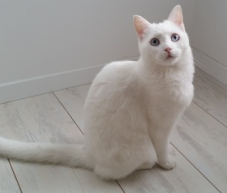


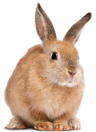
Classification with Neural Networks
p i x e l s
Weights
f
Weights
f
0.7
f
0.1
f
f
0.05
Input image
Predicted class
Victoria Mazo
Notes:
NNs are very successful at image classification.
3

Slide 4
Classification with Neural Networks
In classification a Neural Network learns a function that maps the input data to some desired output class
Victoria Mazo

Slide 5
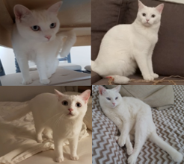
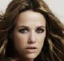
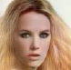
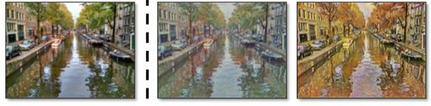
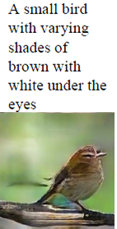
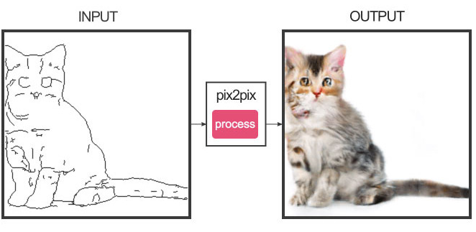
But what if…
Victoria Mazo

Slide 6
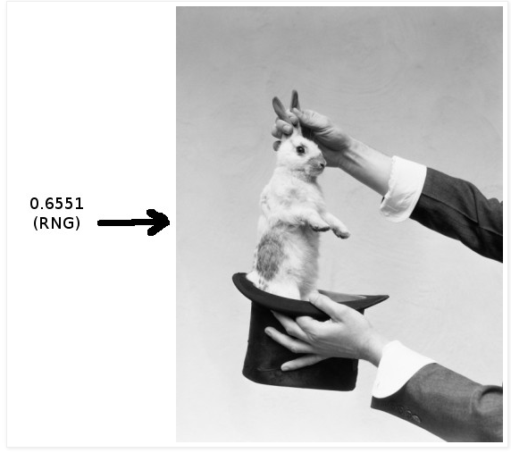
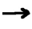
GANs
With Generative Adversarial Networks (GANs) we can convert a vector of random numbers from [0,1] into a picture of a rabbit, for example
[0.256, 0.356, …, 0.001]
Victoria Mazo

Slide 7
GANs
With Generative Adversarial Networks (GANs) we can convert a vector of random numbers from [0,1] into a picture of a rabbit, for example
MAGIC
[0.256, 0.356, …, 0.001]
Victoria Mazo

Slide 8
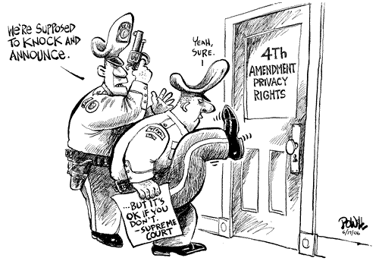
GANs
Two neural networks compete against each other
Generator (“counterfeiters” ) generates fake samples, tries to fool the discriminator
Discriminator (“police”) tries to distinguish between real and fake samples
counterfeiters
Fake
I. Goodfellow et al. 2014
Victoria Mazo

Slide 9
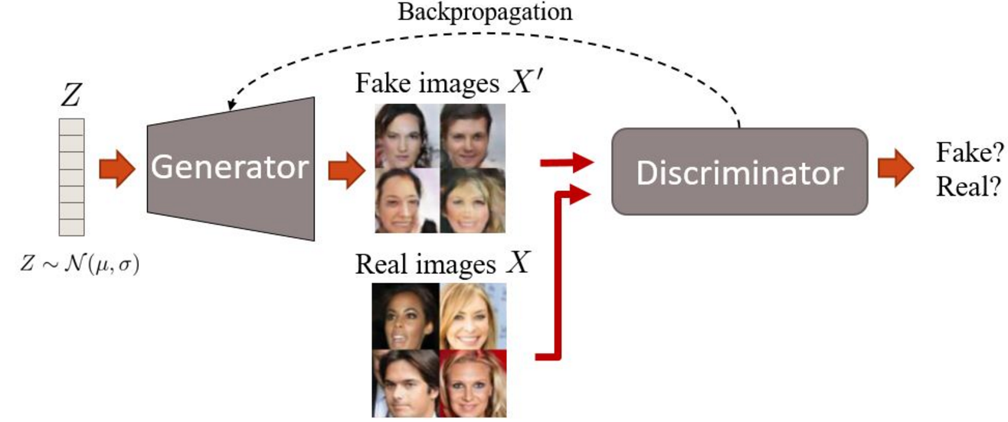
GANs: training
Victoria Mazo
diagram credit – Guim Perarnau

Slide 10
GANs: inference
Victoria Mazo
diagram credit – Guim Perarnau

Slide 11
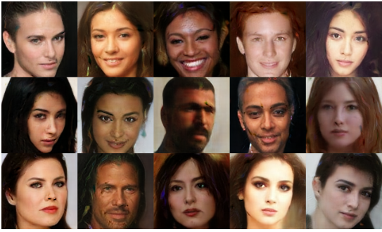
BEGAN – generated faces
Victoria Mazo
Bethelot et al. 2017

Slide 12
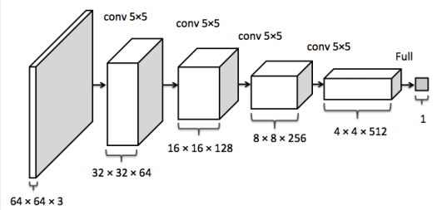
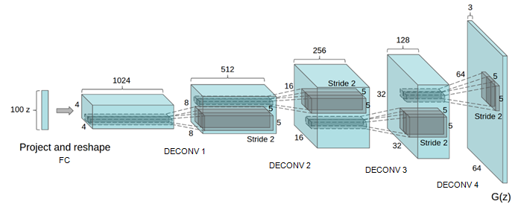
DCGAN
Discriminator
Generator
FC
Victoria Mazo
Radford et al. 2015

Slide 13


Convolution
Fractional convolution (‘deconvolution’)
Output is smaller than the input
Output is larger than the input
Victoria Mazo

Slide 14
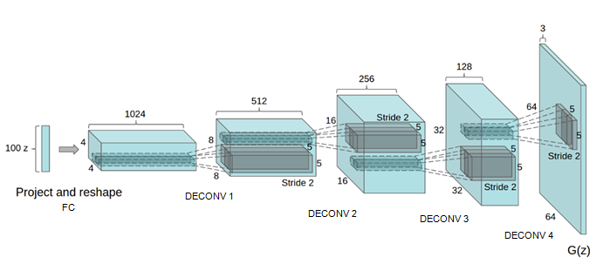
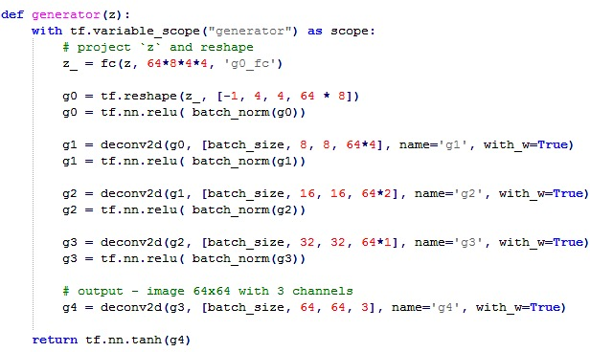

DCGAN : generator
Victoria Mazo
code: https://github.com/carpedm20/DCGAN-tensorflow/blob/master/model.py

Slide 15
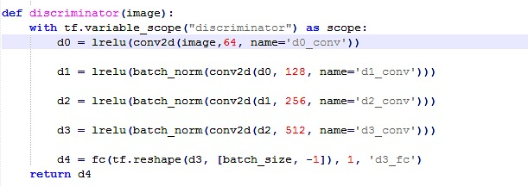
DCGAN : discriminator
Victoria Mazo

Slide 16
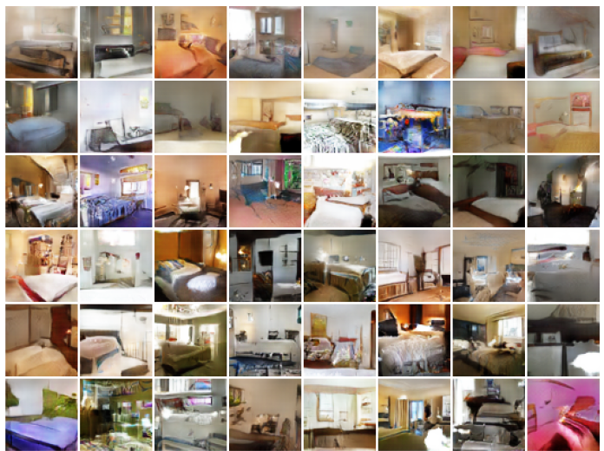
Bedrooms
Victoria Mazo
Arjovsky et al 2017

Slide 17
GANs: inference
Victoria Mazo
diagram credit – Guim Perarnau

Slide 18
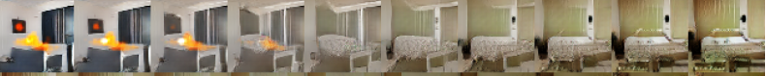
Interpolation
z₁
interpolate
z₂
Victoria Mazo
Radford et al 2015

Slide 19
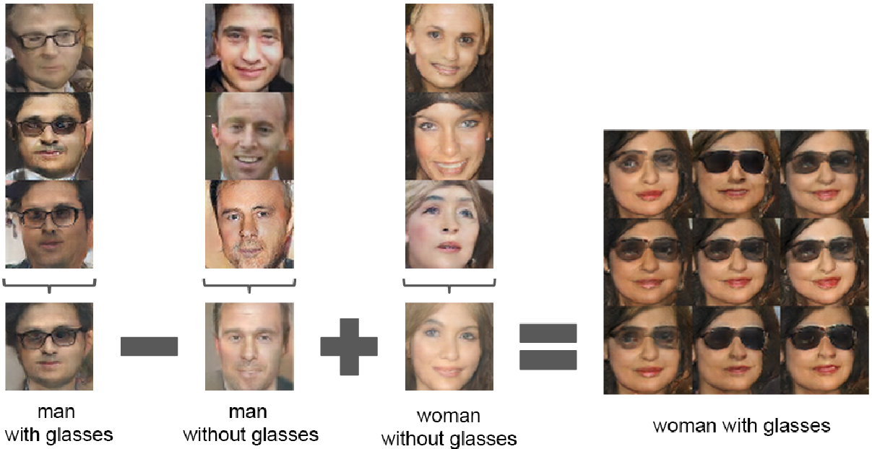
Faces arithmetic
z₁
z₂
z₃
z₄
Victoria Mazo
Radford et al 2015

Slide 20
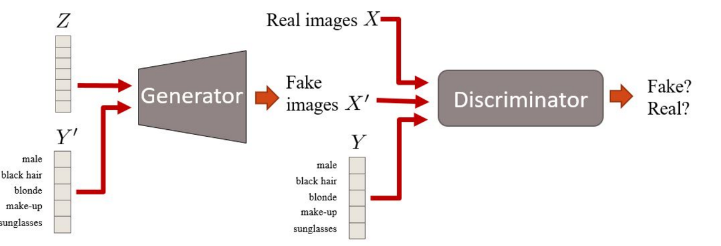
Conditional GAN
Victoria Mazo
diagram credit – Guim Perarnau

Slide 21
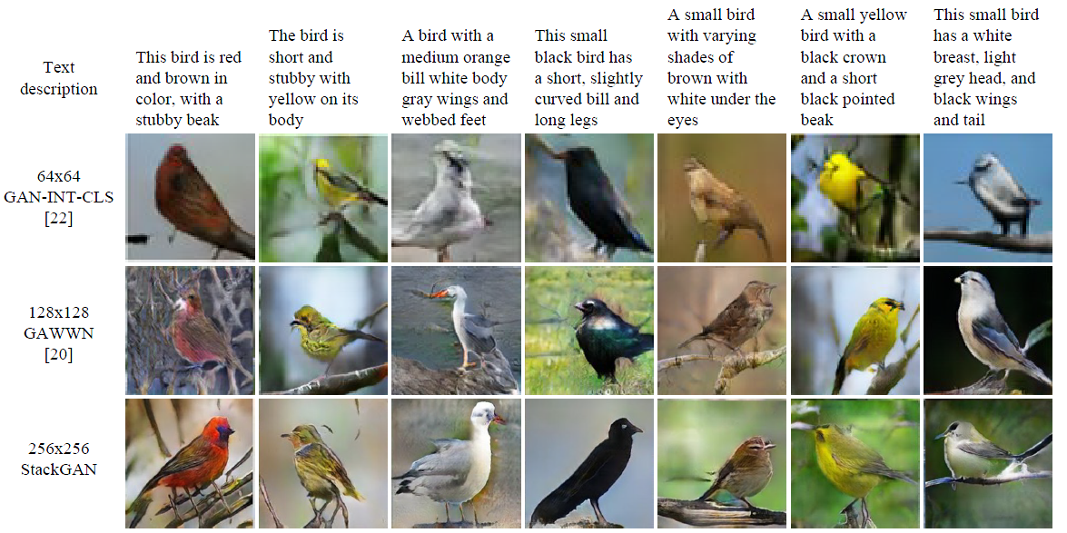
StackGAN
Victoria Mazo
Zhang et al 2016

Slide 22
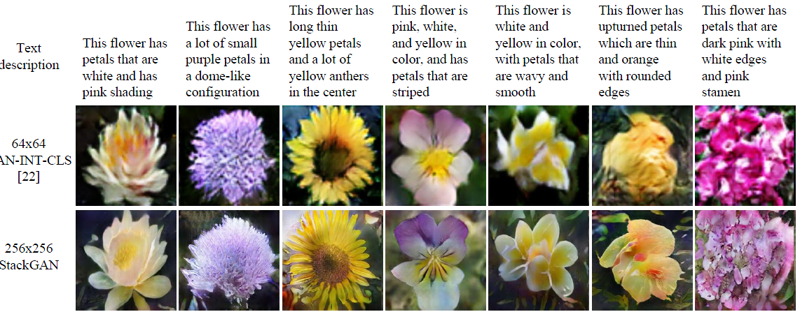
StackGAN
Victoria Mazo
Zhang et al 2016

Slide 23
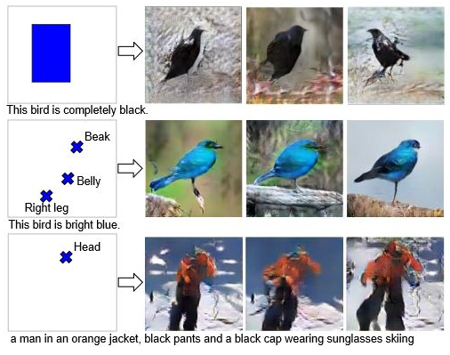
Learning what and where to draw
Victoria Mazo
Reed et al 2016

Slide 24
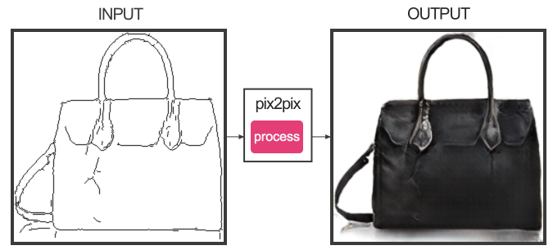
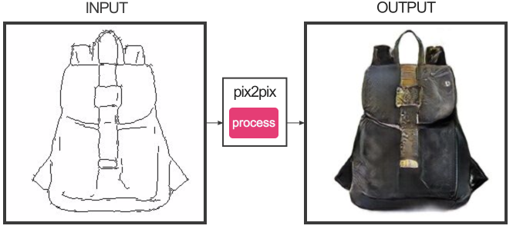
Image-to-image translation
pix2pix
Victoria Mazo
Isola et al 2016

Slide 25
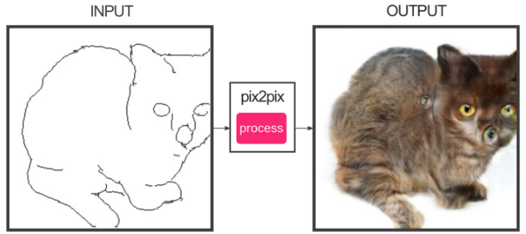
pix2pix
Victoria Mazo
Isola et al 2016

Slide 26
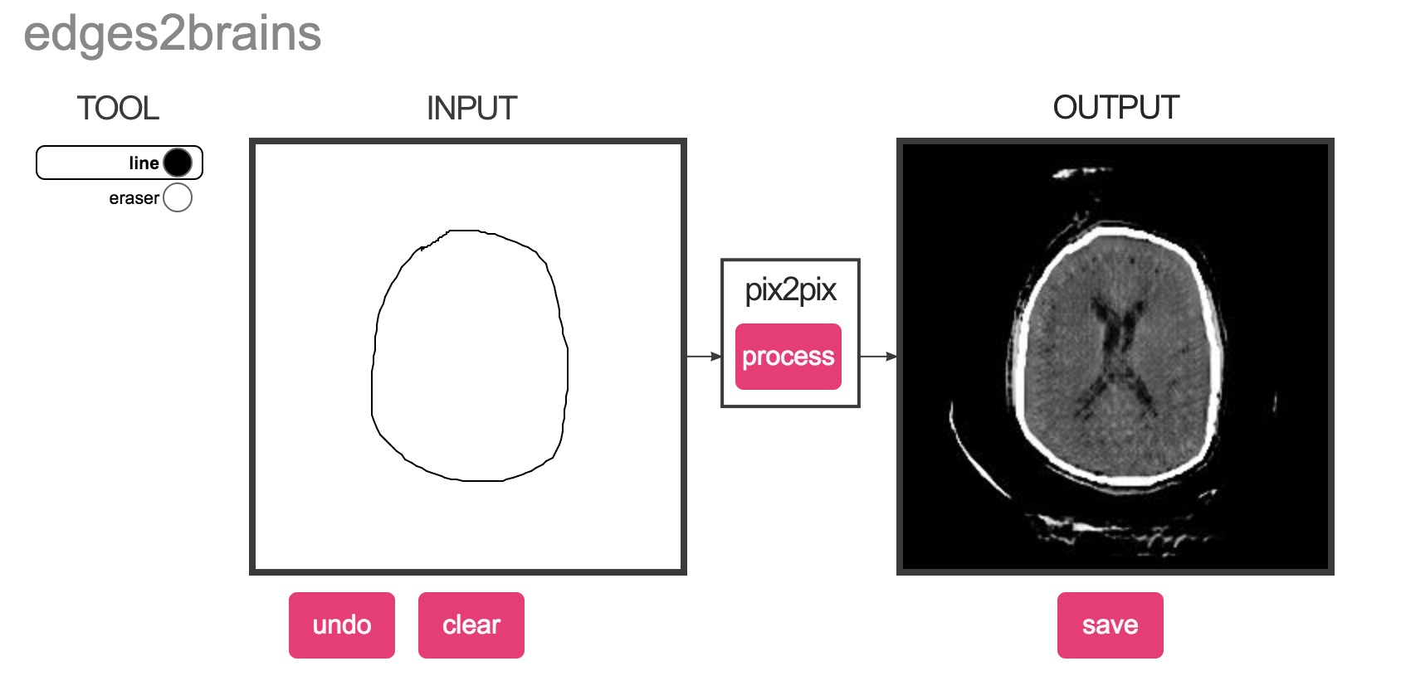
pix2pix
Brain CT generation
Victoria Mazo
Amir Bar

Slide 27
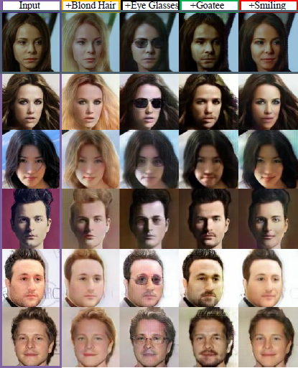
UNIT
Victoria Mazo
Liu at al. 2017

Slide 28
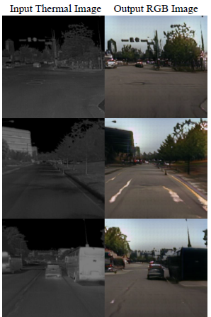
UNIT
Victoria Mazo
Liu at al. 2017

Slide 29
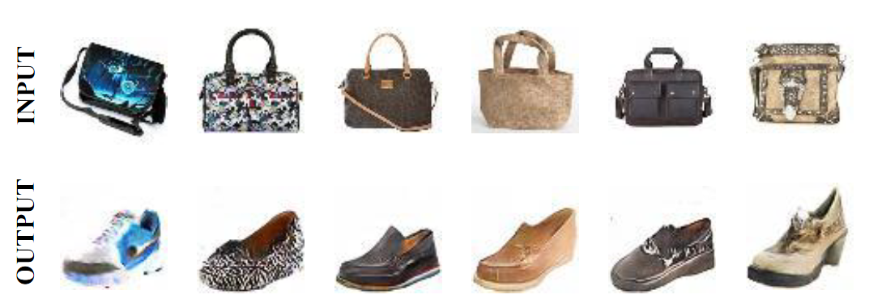
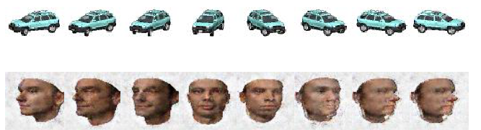
DiscoGAN
Edges to photos
Car to face
Victoria Mazo
Kim et al 2017

Slide 30
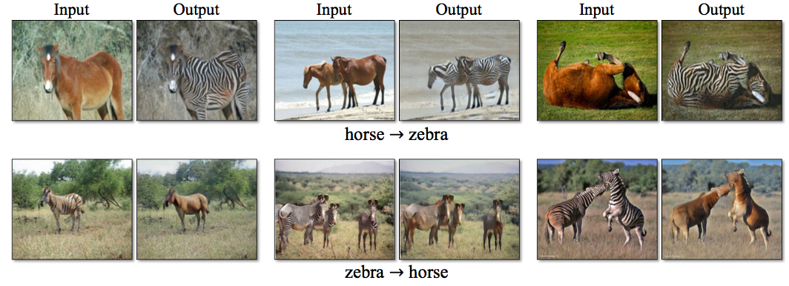
CycleGAN
Zhu et al 2017

Slide 31
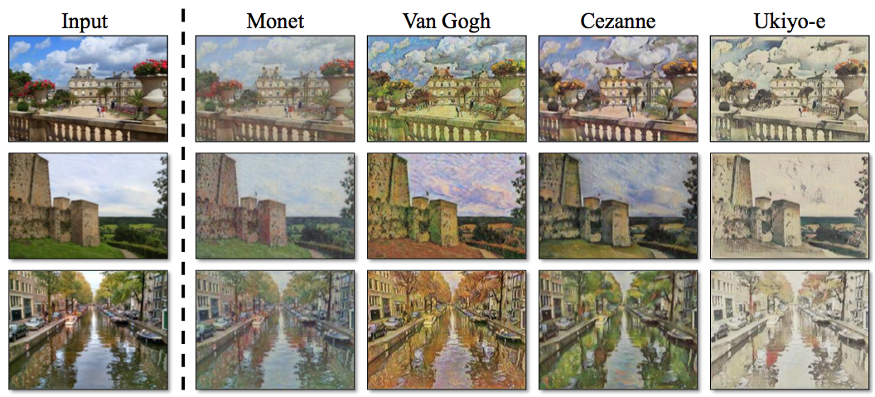
CycleGAN
Zhu et al 2017

Slide 32
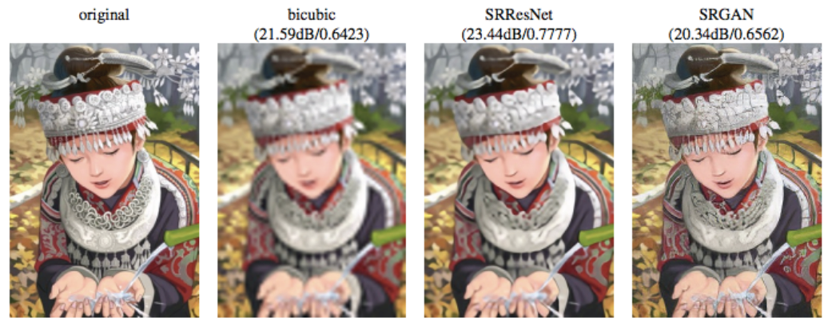
Single image super-resolution
Victoria Mazo
Ledig et al 2016

Slide 33
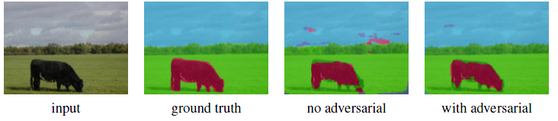
Segmentation with GANs
Victoria Mazo
Luc et al 2016

Slide 34
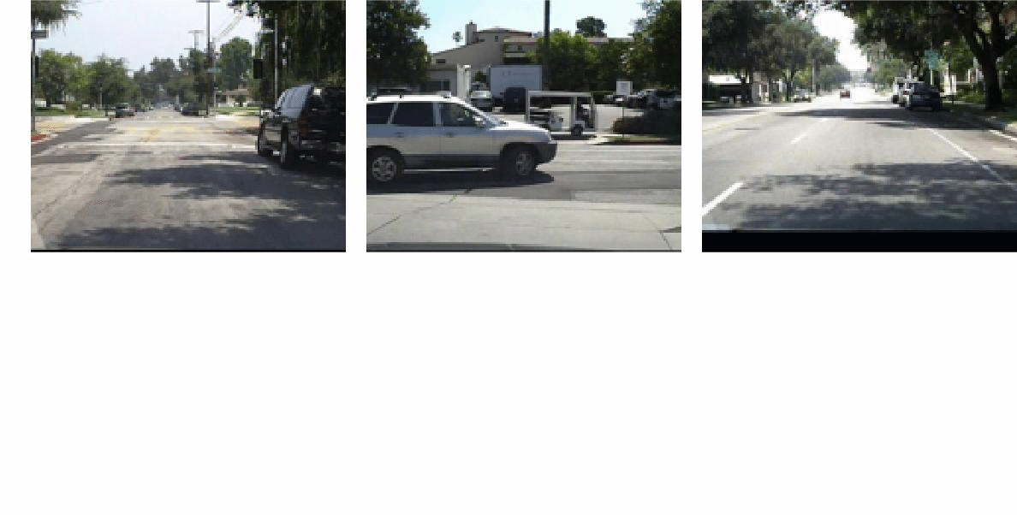
Next frame prediction
Victoria Mazo
Lotter et al 2016

Slide 35
Summary
GANs can be trained to draw realistic sharp images
Intensive research in the field
Yet many unexplored applications of GANs

Slide 36
Tutorials
Blog ”Fantastic GANs and where to find them”
guimperarnau.com/blog/2017/03/Fantastic-GANs-and-where-to-find-them
Stanford course “Convolutional Neural Networks” (Python)
cs231n.stanford.edu/
(video) archive.org/details/cs231n-CNNs
Kadenze course (TensorFlow)
kadenze.com/courses/creative-applications-of-deep-learning-with-tensorflow-iv
Book on Deep Learning by I. Goodfellow
deeplearningbook.org

Slide 37
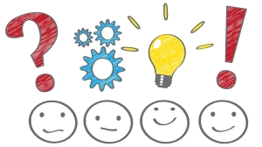
Questions

